Slide 1
Carbon offset program:
First of all let us know about what is carbon offset .
A carbon offset broadly refers to a reduction in GHG emissions – or an increase in carbon storage (e.g., through land restoration or the planting of trees) – that is used to compensate for emissions that occur elsewhere.

Slide 2
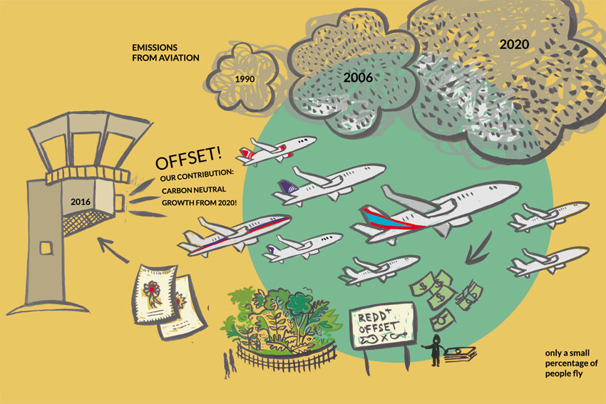
What actually happens in carbon offset programs.
Carbon offset programs allow individuals or companies to invest in carbon offset projects, locally or internationally, as a way of balancing their carbon footprint. For example, an individual can invest money in a wind power project in Costa Rica to offset the amount of carbon produced by their daily commute

Slide 3
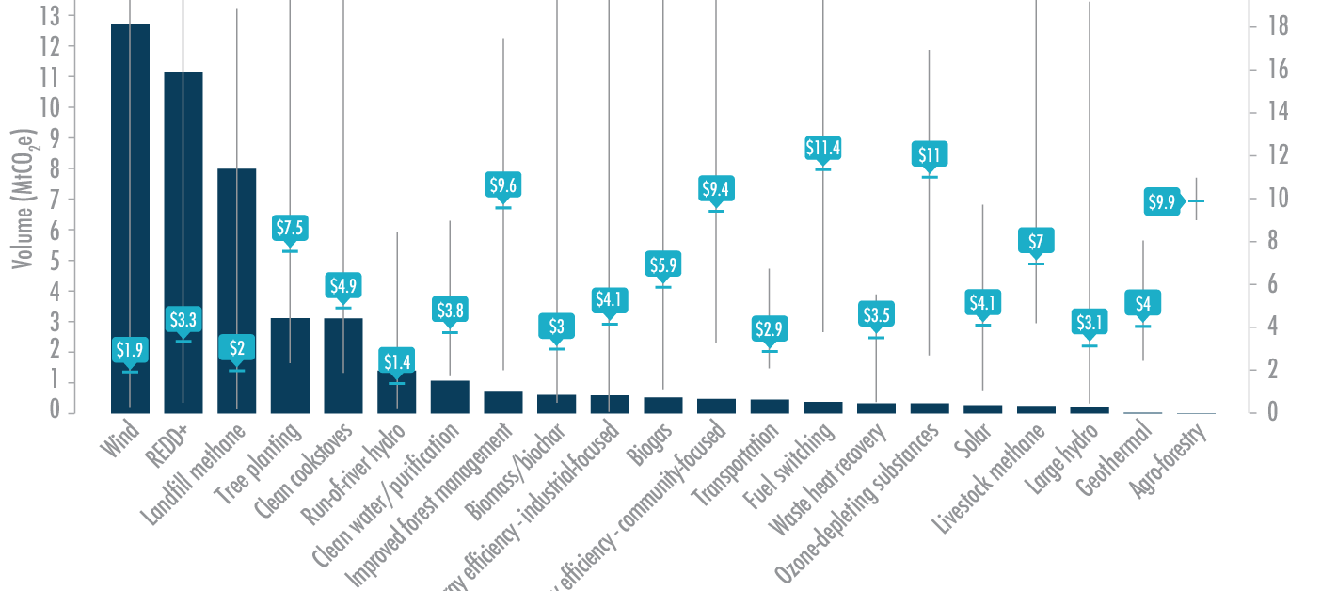
How much does it cost to offset 1 tonne of carbon?
A shadow price that is consistent with net-zero would start at £50 (with a range of £40–100) per tonne of carbon dioxide (tCO2) in 2020, reaching £75 (£60–140) in 2030 and £160 (£125–300) per tCO2 in 2050, which reflects the likely cost of negative emissions technology.

Slide 4
Effects and ways to overcome to this situation.
If we add up all the carbon dioxide released for each person in the country based on our use of fossil fuels and calculate the number of trees you need to take up the carbon dioxide released, the total is equivalent to about 730 trees per person, or roughly 7 acres of forested land.
In this program our software will works as an invester which will invest in different carbon offset programs to overcome this vast and vital situation.
Now the question arises that how we will raise the fund to invest ,for this we have an brilliant solution for that we will make deal with upcoming revolutionary project of 5g

Slide 5
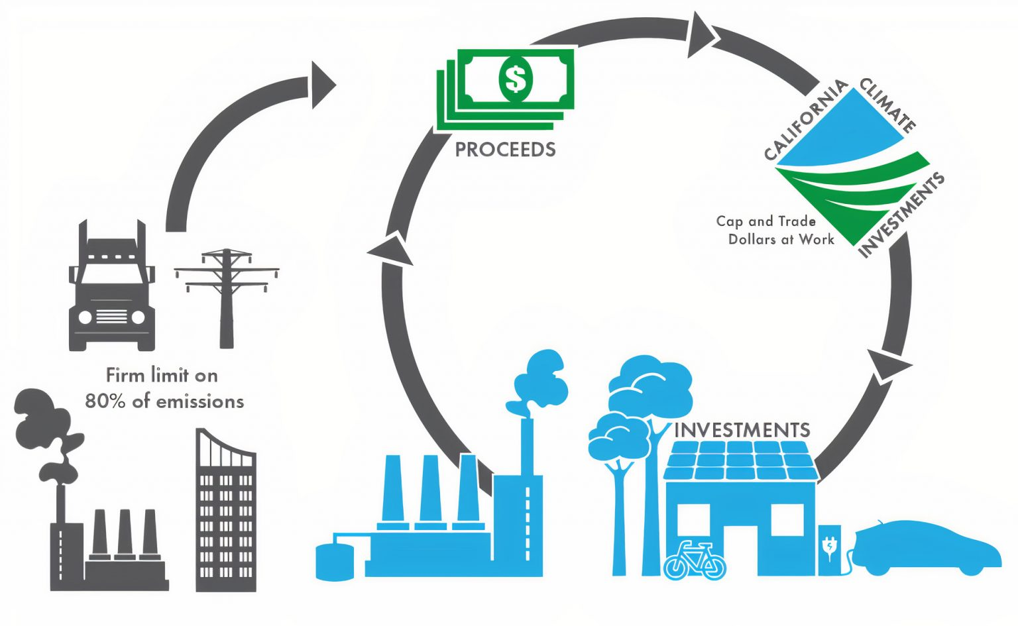
How to Deal with companies
Lets talk about how we are going to bring companies to take interest in our project.
For this we will show them the amount of disturbance they are creating to the environment.
And then we will present our scheme that on every purchase of recharge packs, its 2 to 3 % will be gets credited to our software and from that funding we will invest to other small carbon offset agencies.

Slide 6
What will the benefits of this website
All the transactions will be transparent .
Faster than others comparatible websites existing now.
Fully automated
Etc.

